Slide 1
SRIP Report
- Jay R.

Slide 2
Etching
It is a technique used in printmaking and microfabrication to create patterns on a surface. In etching, a metal plate or other surface is covered with a protective coating, called a resist. The design is then drawn onto the resist, and the unprotected areas are exposed to an acid or other etching agent. The etching agent eats away at the exposed surface, creating a recessed design. The resist is then removed, and the resulting etched design can be used to create a print or other object.
PR (photoresist material) with mask(for photolithography)
Oxides
Etchant(acid)
Link for PPT containing more experiment results: https://docs.google.com/presentation/d/1USQrsLDq276-W_XptNVbxH2zSrA5TdnCdC98zk5NH_M/edit?usp=sharing

Slide 3
TCAD
The main file types used in Sentaurus Topography are:
Command file (*.cmd) - This is the main input file for Sentaurus Topography, containing all the simulation commands.
TDR boundary file (*.tdr) - This file stores the boundaries of the structure and surface plots, and can be loaded into Sentaurus Visual for visualization.
PMC file (*.pmc) - This file stores the information about structure which can also be reused in other files.

Slide 4
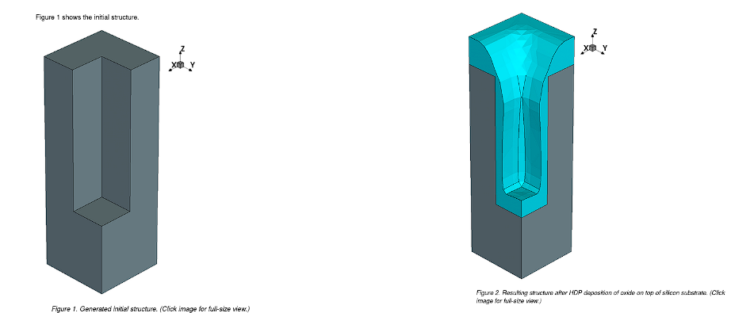
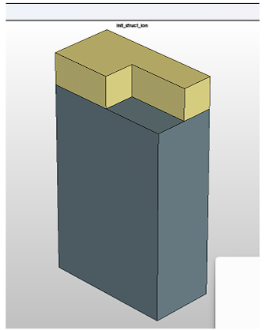
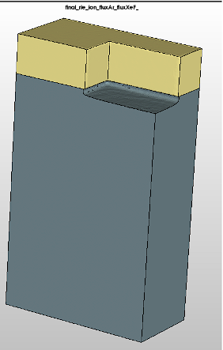
Examples of Deposition and Etching

Slide 5
Machine Learning/Deep Learning models

Slide 6
Proposed Working
Prediction of etched Dimensions
Model 1
(Prediction of etch depth)
Model 2
(Prediction of radius/CD)

Slide 7
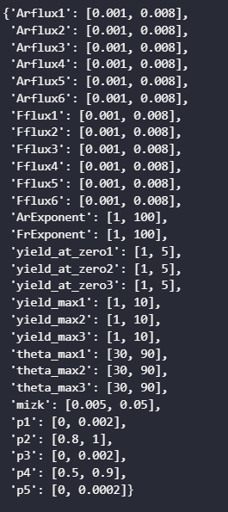
Inputs (Data with time changing flux)
Here, we have 30 parameters which combinedly defines a particular process and we have created dataset for 500 such unique processes.
This 500 processes have 6 different time steps which increases our dataset size to 3000 observations.
This dataset has time changing flux which means at each time interval (i.e t = 2 to t=12), we would have diff. Flux values.
time: [2,12]

Slide 8
Model 1
I/O Description:
Inputs for model-1 would be all those 30 parameters for each time step.
Number of Observations: 500 * 6 = 3000
(unique datapoints) (time steps)
Model uses mean absolute error (MAE) as a loss function, which is more robust to outliers than mean squared error (MSE).
Output for model-1 would be etch depth for all those 30 parameters at that particular time step.

Slide 9
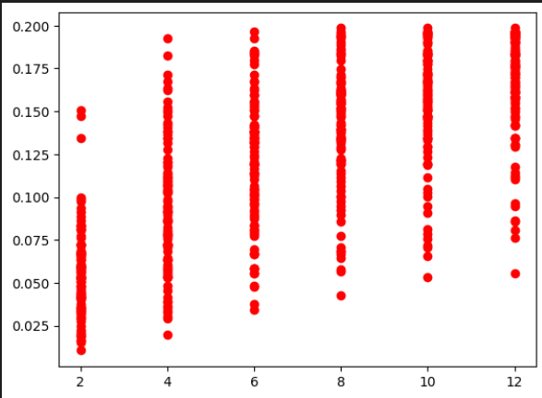
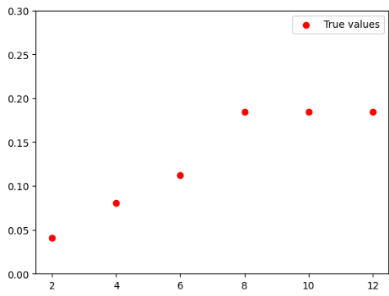
EDA - Model 1
Here, our main aim will be to predict the etched depth for 6 time steps(from 2 to 12) for each unique observation.
Example of a single observation for 6 time steps
D
E
P
T
H
D
E
P
T
H
TIME
TIME

Slide 10
ML/DL models
Models created:
Random Forest Regressor
GNN
LSTM

Slide 11
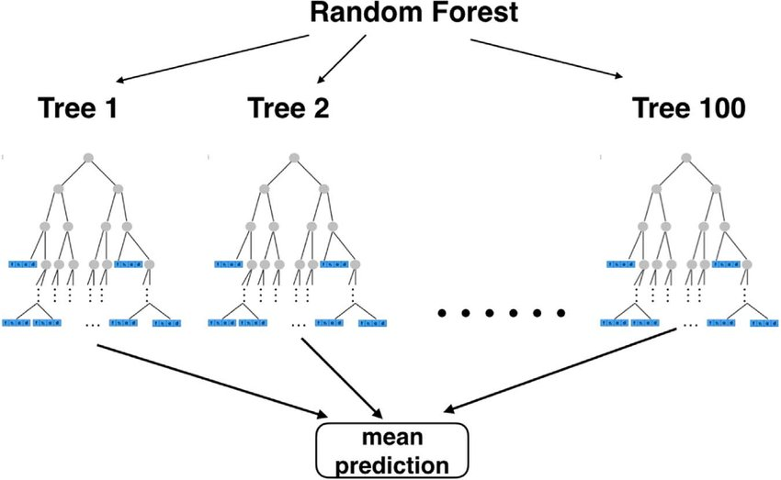
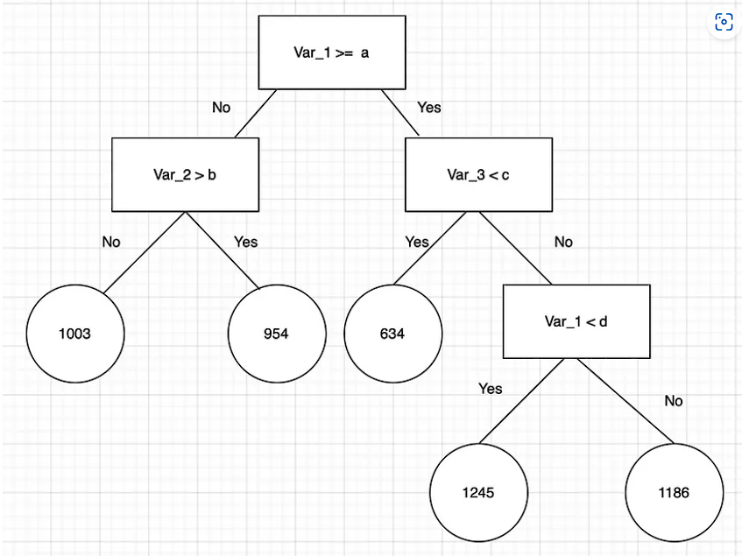
Random Forest Regressor - ML model
It’s nothing but an ensemble technique which uses Random Forest (Basically multiple Decision Trees and picks best one) and Regression methods for predictions.
A Decision Tree

Slide 12
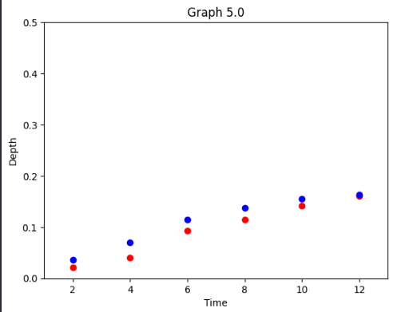
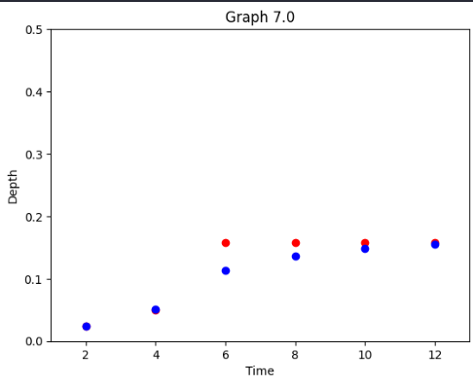
Model’s Performance
Predictions:
Blue: Predicted Values
Red: True Values
Blue: Predicted Values
Red: True Values

Slide 13
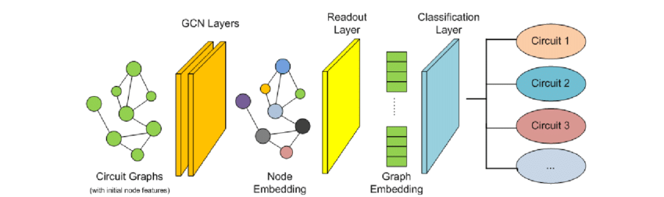
Graph Neural Network (GNN) - Dl model
It is basically a model which can be applied directly to data that can be represented as graphs without prior knowledge of every component within the graph.

Slide 14
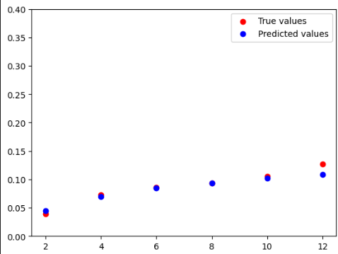
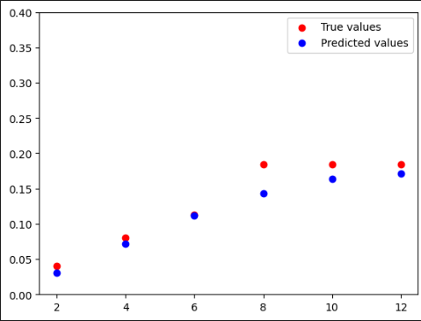
Model’s Performance
Predictions:

Slide 15
Long Short Term Memory (LSTM) Model - DL model
All of these operations are element wise operations
Long term memory
Short term memory
Determines what % of Long Term Memory should be remembered and passed forward
Current Input

Slide 16
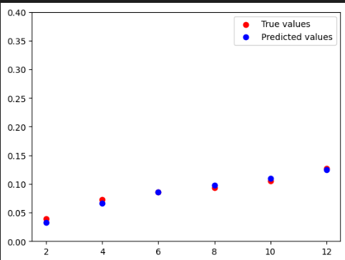
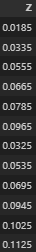
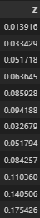
Model’s Performance
Predictions:

Slide 17
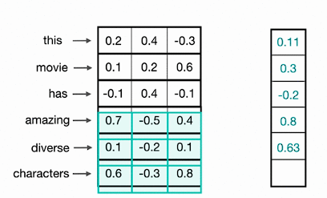
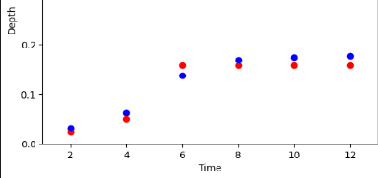
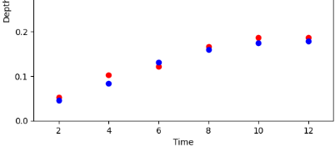
LSTM with slight upgrade
As we know, CNN has convolutional layers which extracts important information/features from data, which is why it’s preferable and the output is shown below:
Blue: Predicted Values
Red: True Values
Blue: Predicted Values
Red: True Values

Slide 18
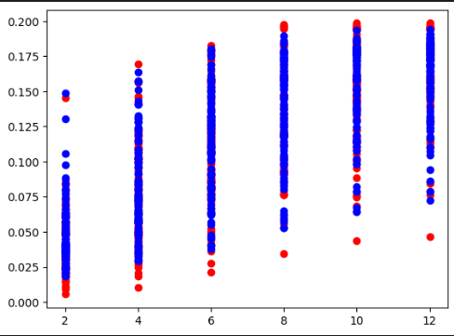
Best Model Performance
LSTM (with or w/o slight upgrade) performs well with the accuracy of >70% which can be seen from below:
Model | Relative MAE (%)
Random Forest Regressor | 23
GNN | 31
LSTM | 16
LSTM with slight upgrade | 12
The reason why any model could not exactly predict all of the values could be because insufficiency of training data to cover all possibilities of testing data.
To improve the accuracy of model, we can create more data wrapping real world necessities.

Slide 19
Model - 2
I/O Description:
Inputs for model-2 would be all those 30 parameters for each time step and also Z axis values (i.e height) upto etched depth predicted by Model 1
Number of Observations: 500 * 6 = 3000
(unique datapoints) (time steps)
Model uses mean absolute error (MAE) as a loss function, which is more robust to outliers than mean squared error (MSE).
Output for model-2 would be Average Fitradius (Critical Dimension) for all those 31 parameters at that particular time step.
3000 * (z-axis coordinates upto etched depth) ~= 75000 observations

Slide 20
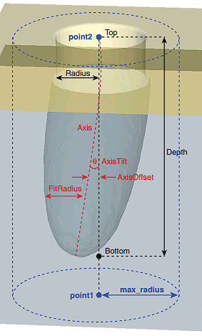
Below is an exemplary image showing all parameters that are available as CD in Sentaurus Topography and we have taken Depth and Average Fitradius for the model.

Slide 21
ML/DL models
Models created:
LSTM

Slide 22
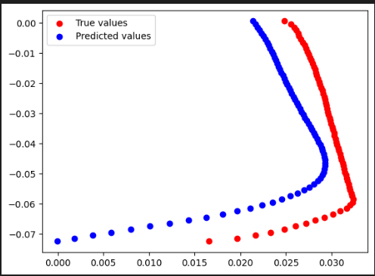
LSTM model performance
We can see that our model is performing poorly which might be due to overly-complex data.
Decreasing complexity of data by reducing features shows huge improvement in model’s output which is shown in next slides where we have used constant flux instead of time changing flux.
D
E
P
T
H
Avg Fitradius (CD)
Relative MAE (%): 40 - 45

Slide 23
New Data (Replacing time changing flux with constant flux)

Slide 24
Inputs (Data w/o time changing flux)
Here, we have 20 parameters which combinedly defines a particular process and we have created dataset for ~ 500 to 1000 such unique processes.
These processes have 6 different time steps which increases our dataset size to ~6000 observations.
Arflux: [0.001, 0.0079]
Fflux: [0.001, 0.007]
time: [2,12]

Slide 25
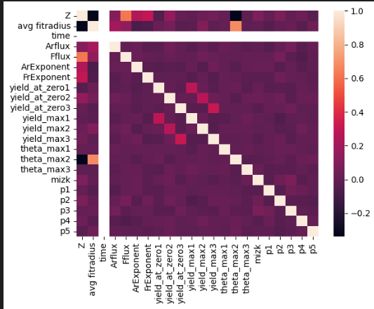
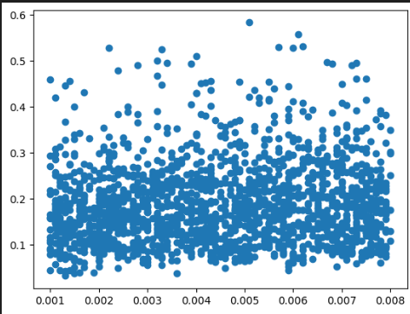
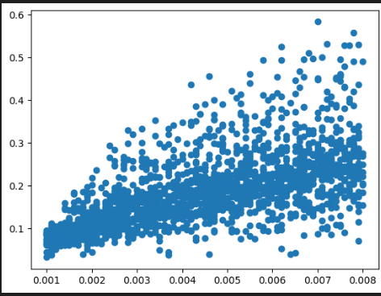
This dataset with constant flux is relatively simpler than our previously generated data and thus allowing us to achieve better accuracy.
Below is for t = 12
Z vs F flux
Z vs Ar flux
Showing that F flux has more impact on etching

Slide 26
Model 1 [data with constant flux] (Prediction of etch depth)
Our previous model 1 for relatively more complex data showed satisfactory accuracy which is why it would also show better accuracy here.
That’s why, I preferred improving model 2 which was inaccurate for seeing changes.

Slide 27
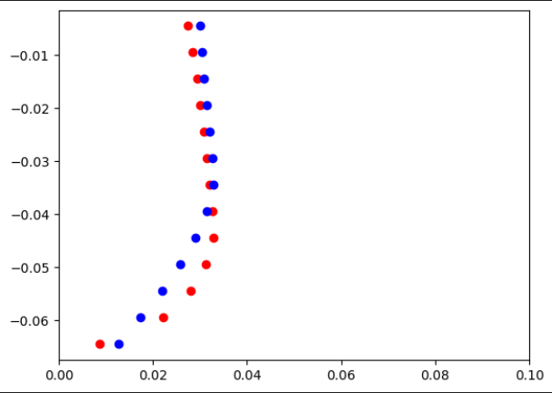
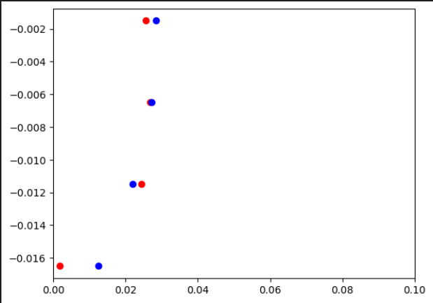
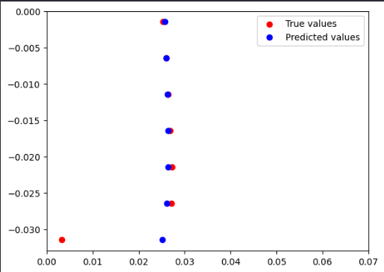
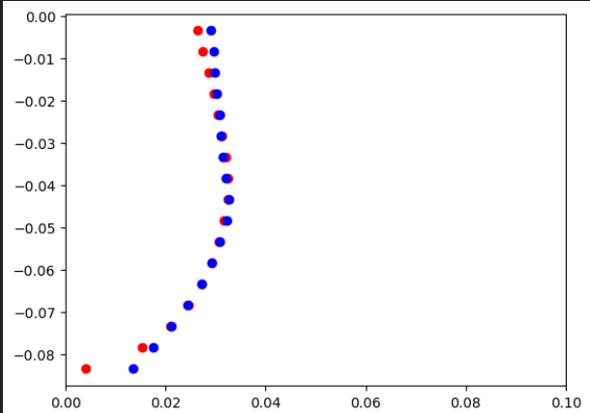
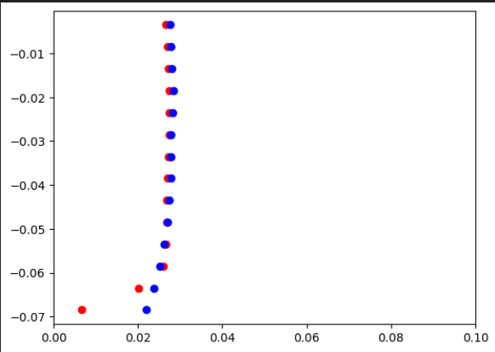
Model 2 [data with constant flux] (Prediction of radius/CD) LSTM
t=2
D
E
P
T
H
Avg Fitradius (CD)
D
E
P
T
H
Avg Fitradius (CD)

Slide 28
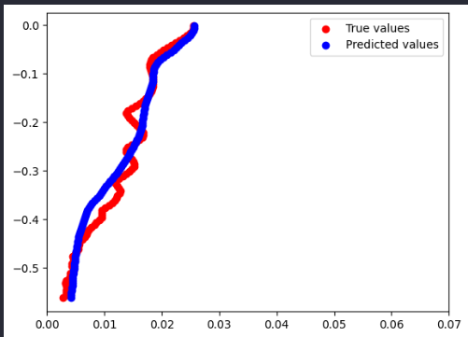
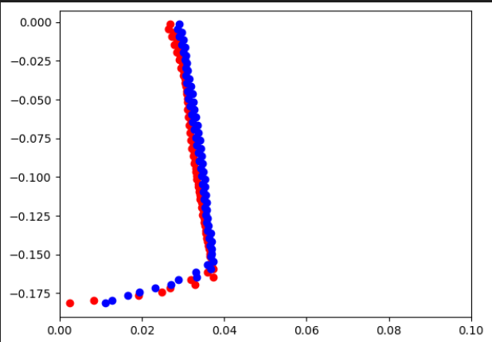
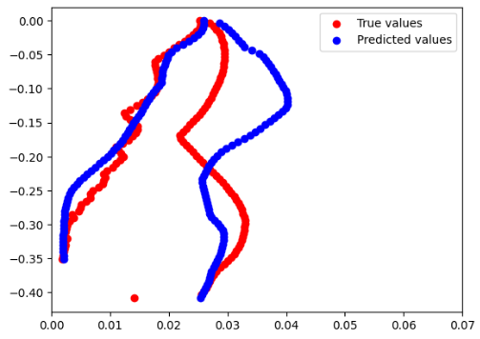
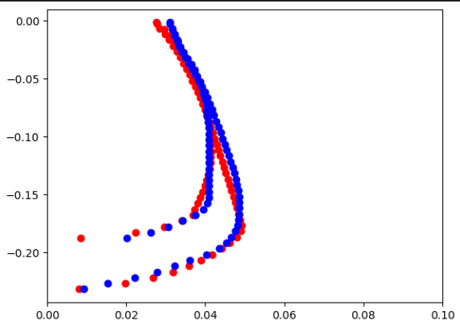
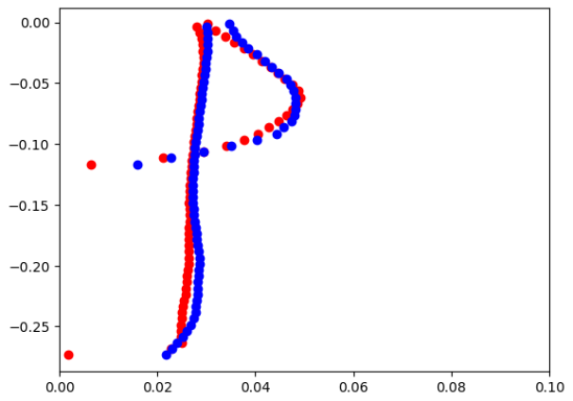
Shows our model’s weak performance due to roughness
t=12

Slide 29
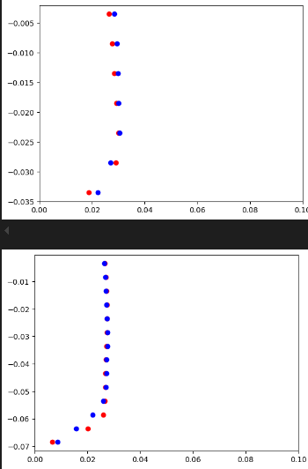
RNN

Slide 30
Models like RandomForestRegressor are insignificant as they don’t have any memory.
As the data’s complexity grows, so does the necessity of using a better ML/DL model and GNN, LSTM would perform significantly better on increasing complex data.
LSTM outperforms GNN in terms of Relative MAE and that’s why it could be more preferable.
Model-2 gained far more better accuracy for data with constant flux showing that if somehow we make some adjustments by data analysis and reduce dimensions a little then it would have greater impact on accuracy.
Following table summarizes the best model’s Relative MAE for both types of data achieved so far:
 | Model 1 (Prediction of etched depth) [RMAE (%)] | Model 2 (Prediction of CD/fitradius) [RMAE (%)]
Data with time changing flux | 12 | 40 - 45
Data with constant flux | 7 | 15

Slide 31
Gate All Around Field Effect Transistor (GAAFET)

Slide 32
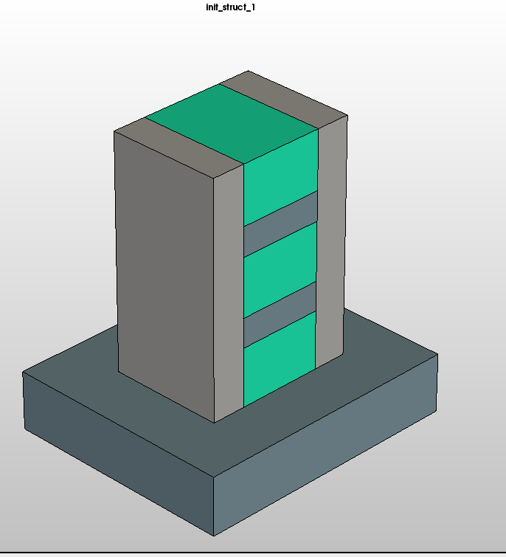
Structure 1 - Channel Release (To Completely remove SiGe layer)
Silicon Nitride - 6 nm width
SiGe - 10 nm thickness
Silicon layer
5 nm
Silicon Base
10 nm

Slide 33
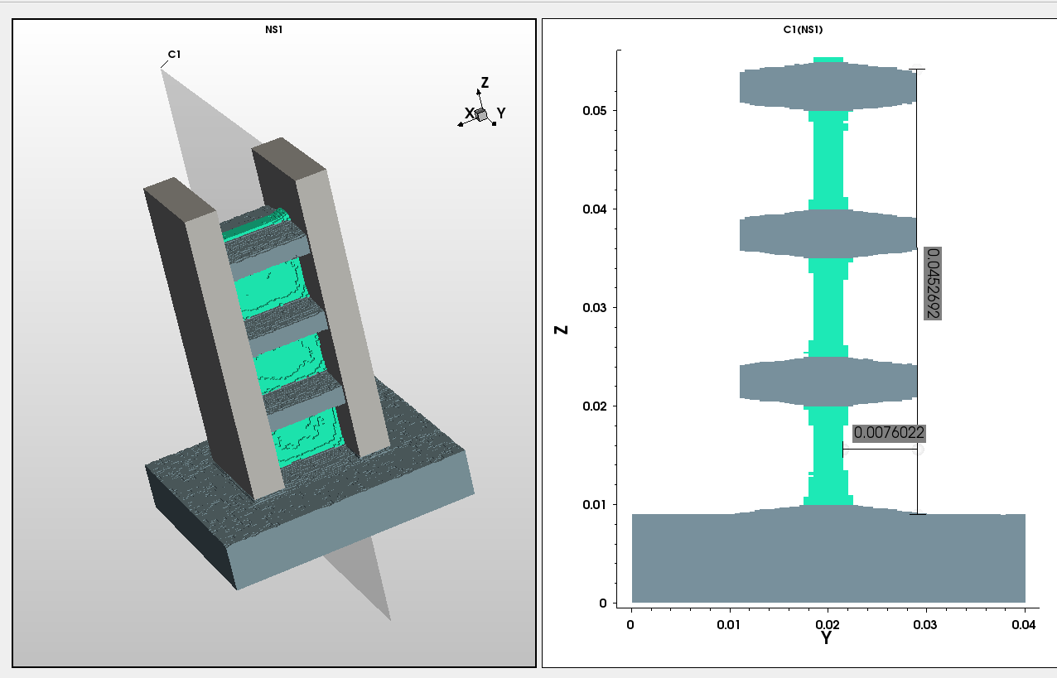
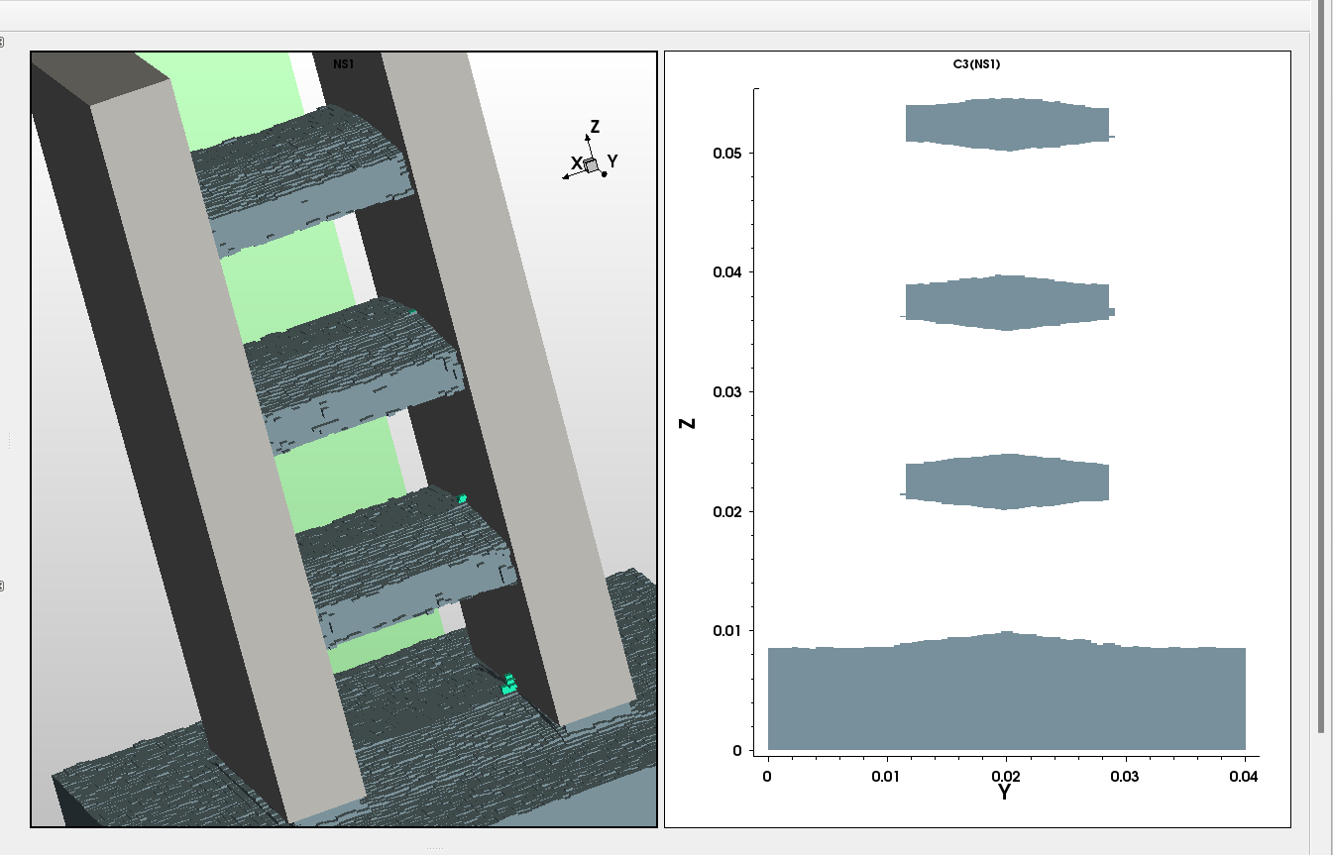
Effect of flux on process outcome
- Flux = 2 x 10^-3, time = 5 s - Flux = 3.9 x 10^-3, time = 5 s
Flux describes the incoming flux of particles on surface.
More flux means more etch rate.

Slide 34
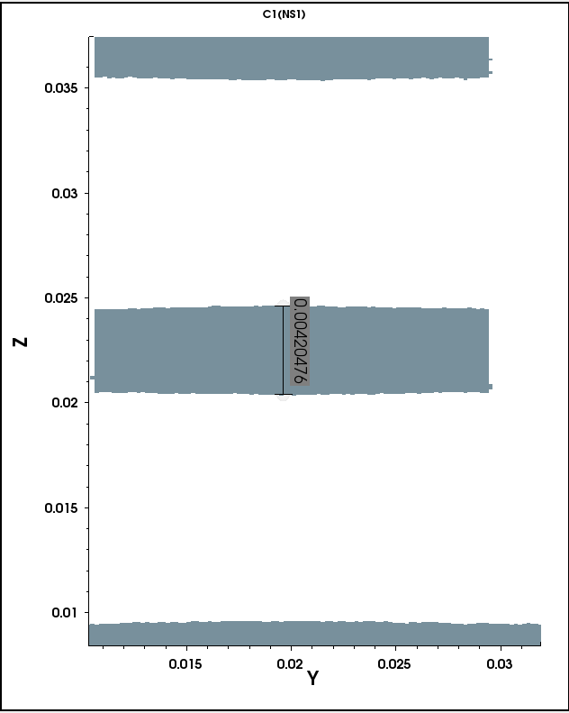
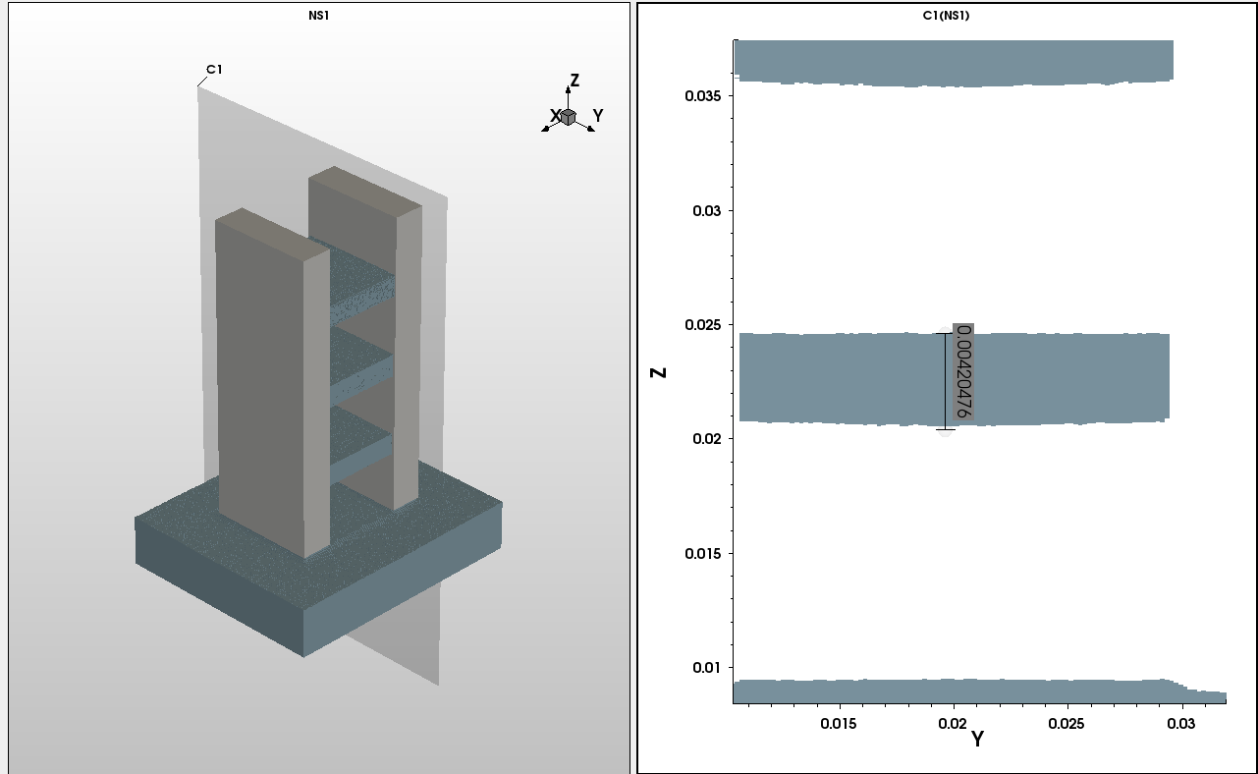
Effect of exponent on process outcome
Exponent gives the angular distribution of incoming particles’ flux, i.e If Value of exponent is more, the etching process would be more anisotropic which means that etching would be more in particular direction.
Exponent = 1 [Time and Flux are same for both] - Exponent = 5000

Slide 35
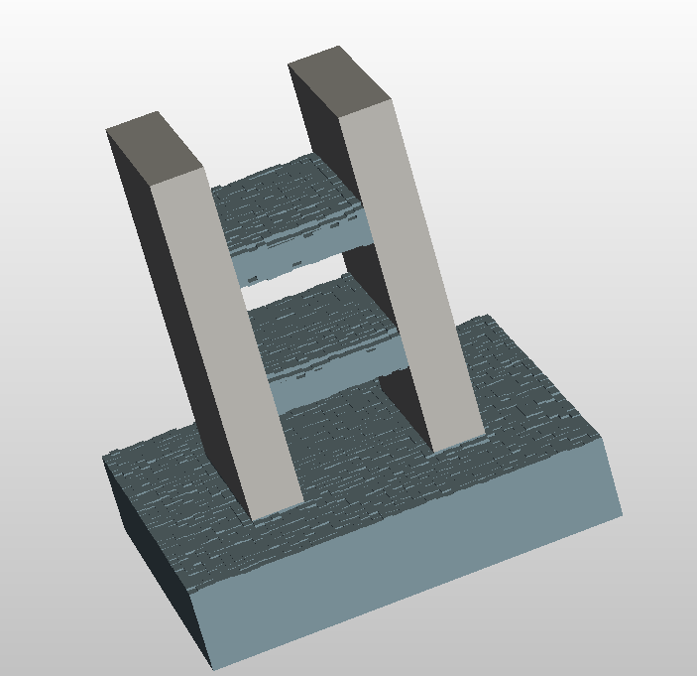
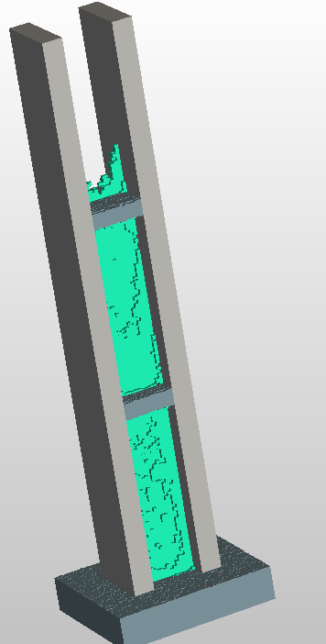
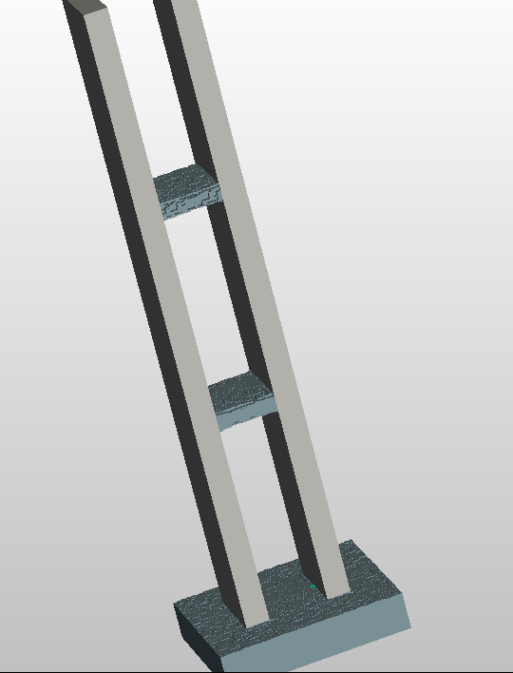
Effect of increasing thickness of SiGe layer
-For t = 1.7 s, actual - Increasing 5 times from 10 nm to 50 nm, t = 1.7 s. - t = 3.5 s

Slide 36
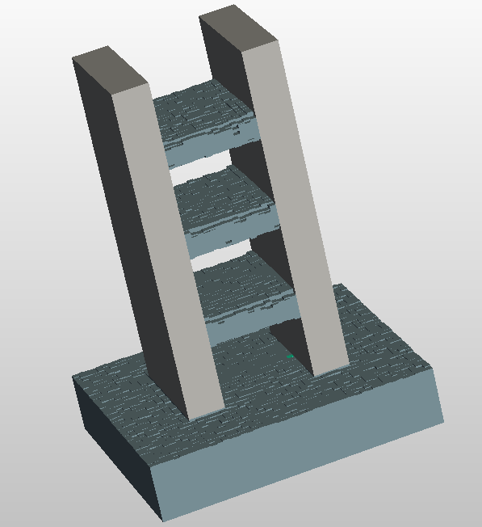
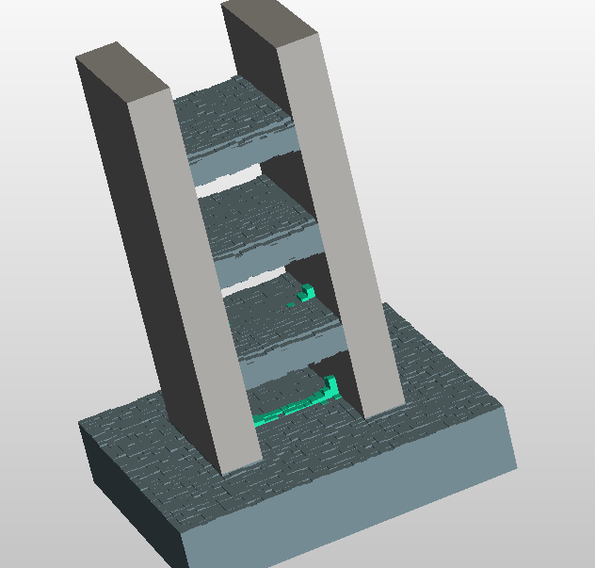
Effect of increasing number of layers
-For t = 1.7 s, actual - For t=1.7s, +1 layer - For t=2 s, +1 layer

Slide 37
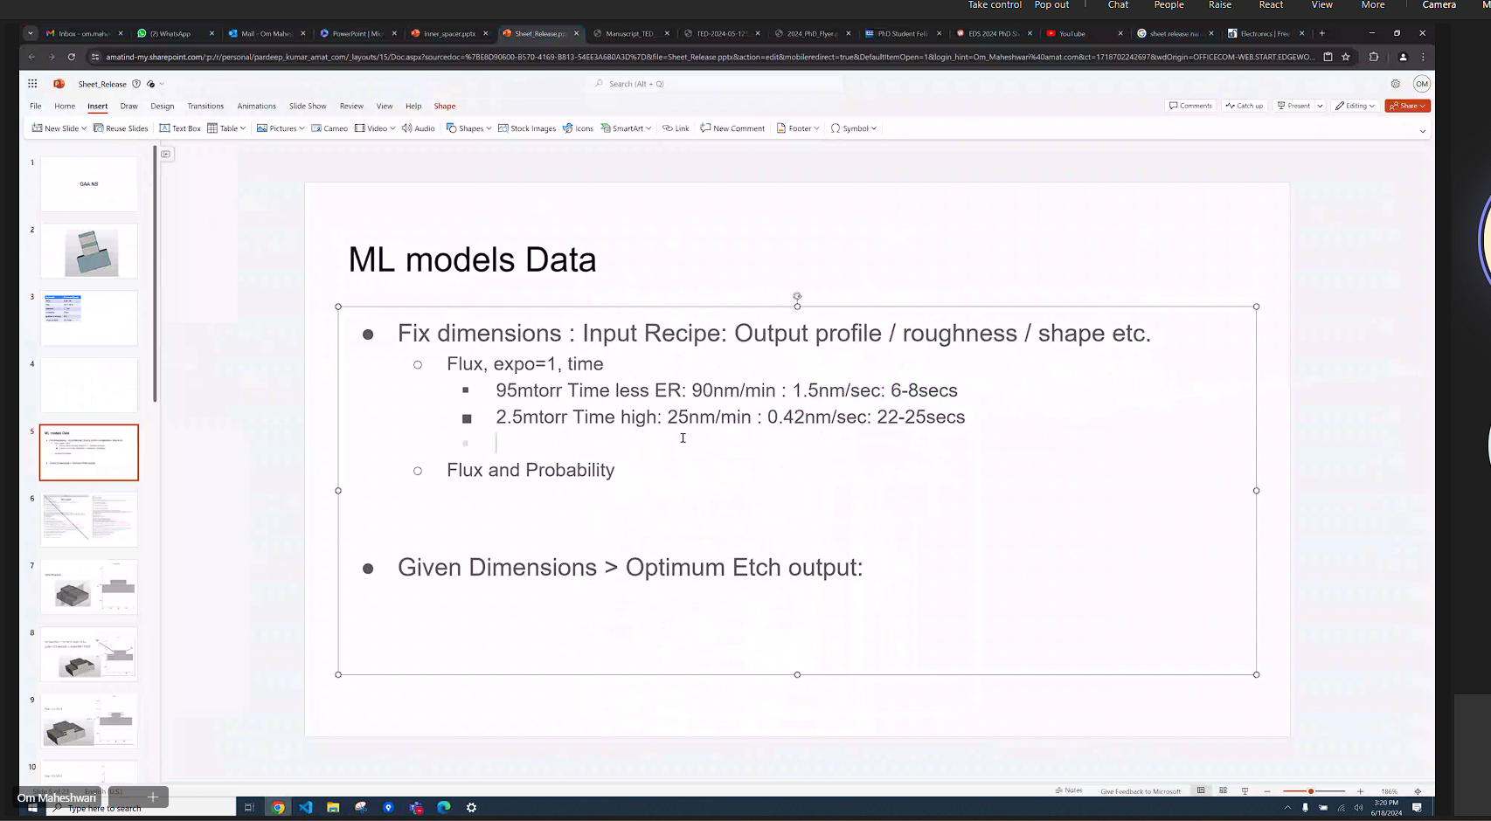
References - Sci-Hub | Selective etching of Si1−xGex versus Si with gaseous HCl for the formation of advanced CMOS devices. Thin Solid Films, 517(1), 93–97 | 10.1016/j.tsf.2008.08.081
The above referenced paper shows a detailed study of variation of etching of SiGe layer with change in partial pressure of HCL resulting to a show a certain amount of etch rate of SiGe.
We tried to incorporate the same knowledge by mimicking that same etch rate of SiGe shown in paper.

Slide 38
Below table showing the range of varying fields/quantities like Flux and Time:
Flux | Time | Flux range (20%) 0.72 to 3.72 x 10^-3 | Range (20%) 4.96 to 27.6 s
3.1 x 10^-3 | 6.2 s
0.9 x 10^-3 | 23 s
From figure above of simulation which simulated etching for 5 seconds;
Etched depth= 7.6 nm
This image shows that we have achieved ~1.5 nm/sec etch rate of SiGe.

Slide 39
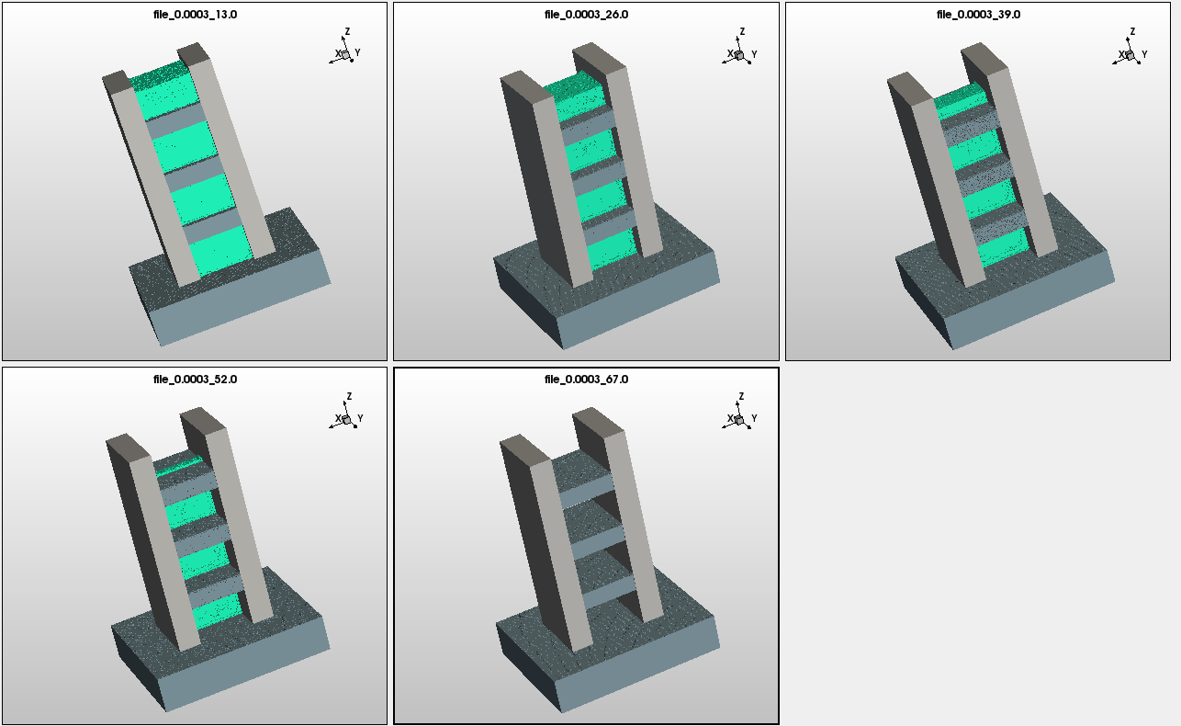
Created data for 70-80 distinct flux values for 5 time intervals each
One example flux value:

Slide 40
Division of process into sub-processes
This problem can be further processed into two ways:
Predicting thickness of SiGe layer at intermediate times
Predicting Average Roughness of the whole surface

Slide 41

Model - To predict thickness of SiGe layer at intermediate steps
This model would predict the remaining SiGe layer at intermediate time steps before SiGe is completely etched.

Slide 42
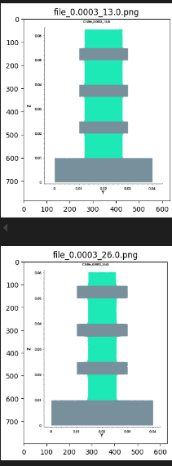
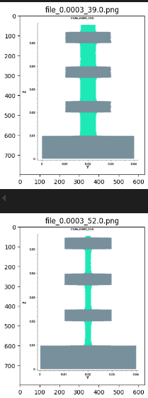
Generated data for the model
This dataset contains images of a 2D plot showing the remaining thickness of SiGe layer for each distinct flux value at 4 intermediate time steps.
As this is a dataset containing all of the images, we should use Convolutional Neural Network (CNN) which is the most preferred model for visual type of data.

Slide 43




Results of the model
Used ANN & two loss functions:
MAE (Prediction of a obs. from training data itself) - Relative MAE:

Slide 44




Cropping and resizing the input images
Input: (Training data) Output:

Slide 45

Model - To predict average roughness
This model would predict average surface roughness of remaining silicon layer after complete etch of SiGe layer is done.
The average surface here is calculated at a mid-cut plane on x-axis, accounting for a 2D structure which can be extended to 3D structure by taking average at all x-axis cut planes.

Slide 46

Generated data for the model
We can see some anomalies in trend in the graph which could be because of rounding-off the time at which complete etch of SiGe layer happens.
This can be solved by running the simulations for the exact time of complete etch.
Avg.
Roughness
Flux

Slide 47

Updated data for the model
The plot of graph without time approximation is shown below, which shows exactly different trend of nearly persistent average roughness, seeming more logical like as increasing flux results in decreasing time accordingly.
Avg.
Roughness
Flux

